Slide 1
Introduction to Prescriptive Analytics
Introduction to Analyzing Data for Business Goals

Slide 2
Learning Goals
Evaluate a scenario and discuss how prescriptive analytics can be applied to achieve business goals
Practice optimization by formulating a linear programming model in Excel
Investigate considerations for how prescriptive analytics will help you solve the business problem for your final project
Define prescriptive analytics and the techniques of prescriptive analytics

Slide 3
Prescriptive Analytics
Descriptive: What happened? Helps uncover valuable insight into the data being analyzed
Diagnostic: Why did it happen? Helps understand the relationships and patterns in the data
Predictive: What is likely to happen in the future? Helps forecast the future behavior of people and markets
Prescriptive: What should I do about it? How should we respond to potential future events based on the analysis? Uses optimization and simulation algorithms to provide guidance and understanding on decisions and answers

Slide 4
Prescriptive Analytics
Consider future state from Predictive Analytics and recommend future courses of action for business leaders to follow.

Slide 5
Prescriptive Analytics
What should I do about it?
How should we respond to potential future events based on the analysis?
Uses optimization and simulation algorithms to provide guidance and understanding on decisions and answers

Slide 6
Techniques of Prescriptive Analytics
Commonly used techniques:
Optimization
Decision Variables
Objective function
Constraints
Simulation & Experimental Design

Slide 7
Introduction to Optimization
Introduction to Optimization
Optimization seeks to find an optimal solution to a business problem
All optimization problems have several common elements:
Decision variables
The variables whose values the decision maker is allowed to choose.
Objective function (objective)
To be optimized—maximized or minimized.
Constraints
Must be satisfied—physical, logical, or economic restrictions, depending on the nature of the problem.

Slide 8

Example
For instance, the population of a particular rodent can be described by a mathematical equation that takes into account reproduction and predation (the rate at which rodents are eaten by predators), as well as food availability.
When food starts to run out, the population cannot continue growing, so food availability is a constraint that would need to be expressed mathematically and incorporated into the model.
Another constraint would be the population of predators, which together with limited food supplies places limits on the rodent population.

Slide 9
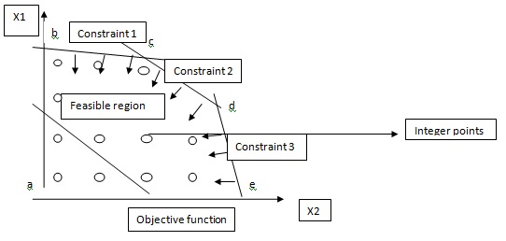
Introduction to Optimization

Slide 10
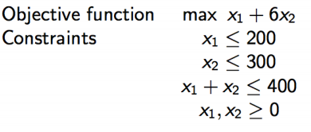
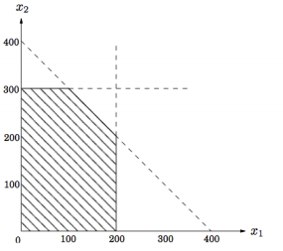
Introduction to Optimization
2
Decision variables
1
3
Constraints
Simplex Method
Optimum Point
Decision variable
a line in the two-dimensional (2D) plane
feasible region:
polygon
Decision variable

Slide 11
Optimization Assignment Farmer Example
Module 7

Slide 12
A Farmer Linear Optimization Problem
A farmer owens 50 acres of land.
A farmer wants to plan cotton or corn.
Each acre needs following resources (for example cotton needs 5 labors and 6 tons of fertilizer), as shown in the table:
Selling Cotton gives $400 profit.
Selling Corn gives $200 profit.
Limited resources to help on this planting
such as: Labor (150 workers) and
Fertilizer (200 tones)
 | Cotton | Corn
Labor (Workers) | 5 | 3
Fertilizer (Tons) | 6 | 2

Slide 13
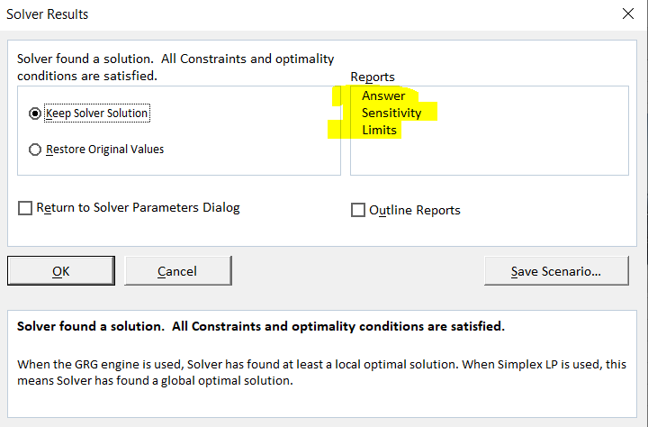
Tasks
Design the LP model to maximize the farmer profit?
Using Excel Solver to find the best “Optimal” solution to maximize profit.
From Excel Solver, select Answer, Sensitivity, Limits reports

Slide 14
Business Challenges in Prescriptive Analytics
Commonly used techniques:
Understanding Your Findings
Decision Variables
Objective function
Constraints
Strategy Decisions
Is a prescriptive model needed?
If a model is needed, which one?
If a model is in place, should it be revised?
If a model is in place, should it be retired?

Slide 15
Prescriptive Analytics Examples
Transportation and Shipping
Prescriptive Analytics has been used to:
Improve driver retention to reduce training costs
Eliminate unnecessary driving, flight, and sea transportation miles
Increase driver productivity by improving routes and eliminating wait times to load/unload
Increase speeds and reduce costs by optimizing distribution networks
Eliminate warehouse packaging errors

Slide 16
Prescriptive Analytics Examples
Financial Services and Banking
Prescriptive Analytics has been used to:
Decrease transaction processing time
Lower transaction costs
Increase the total amount of possible transactions processed in a particular time period
Create better portfolios for financial investment
Optimize financial decisions like when to invest, how much to invest, etc.
Reduce investment risk

Slide 17
Simulation
A simulation model imitates real-world situations mathematically and takes uncertainty into consideration.
The input variables aren’t necessarily fixed but may have ranges or distributions that reflect real-world uncertainty.
Simulation produces a range of output values rather than a single, bottom-line answer.

Slide 18
Simulation
Allows for scenario planning, in which a company uses simulation models to produce a range of possible outputs that correspond to different operating scenarios.
Simulation models are also useful for sensitivity analyses, which allow decision-makers to see how sensitive a system is to changes in operating conditions.
Perhaps best of all, simulations conducted with sophisticated computers make it easy to answer “what-if” questions on the developed computer model without having to build real (physical) systems on which to experiment.

Slide 19
Steps for Applying Prescriptive Analytics
Determine the questions to be answered
Identify scenarios to be investigated
Identify decision objectives, criteria, and parameters
Determine the needs of the end-user
Determine data requirements
Determine the hardware, software, and computational requirements
Prepare a time plan
Develop a cost plan and billing procedure

Slide 20
Internet of Things (IoT)
By 2020, besides computing and communication devices (tablets, phones and PCs), another 38B things will be connected to the Internet
Reasons for incredible growth in IoT:
Hardware – smaller, affordable, more powerful
Availability of BI tools – more capable and cheaper
Emergence of new and innovative use cases
There isn’t a universal agreement on the term, IoT
Web of Things
Internet of Systems, …

Slide 21
IoT Technology Infrastructure
IOT
Hardware
physical devices, sensors, and actuators
Connectivity
Collecting and sending sensory data to the cloud
Software
Integrating, and processing data for patterns
Applications
Creating context specific alerts, actionable insight

Slide 22
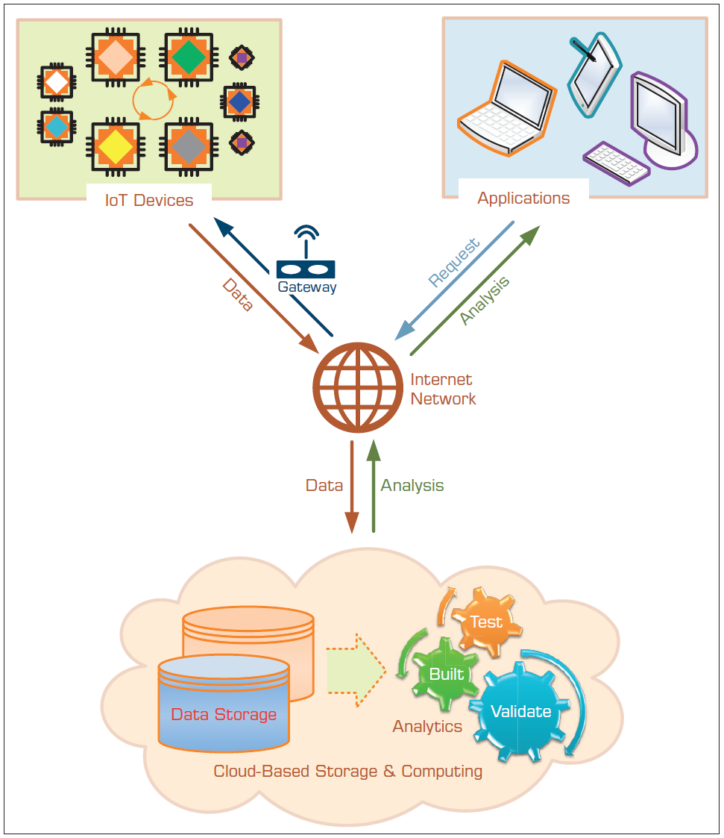
Building Blocks of IoT Technology Infrastructure

Slide 23
RFID Sensors
RFID: radio-frequency identification
One of the earliest/disruptive sensor technologies
Part of a family of automatic identification technologies
Including ubiquitous barcodes and magnetic strips
The Goal is to use of radio-frequency waves to accurately and quickly identify objects
Use of RFID is led/promoted by large retailers
Walmart, Target, Dillard's

Slide 24
RFID Sensors
How does RFID work?
Tag – a circuit attached to the product to be identified
Interrogator (i.e., reader) – with antennas and a computer to detect objects, store the data, and take due actions
Tags can be passive or active
Passive tag – small, inexpensive, no power source
Active tag – larger, more expense, has power source
Which one is better?
Retail uses passive tags, others may use active tags
RFID + Sensors can be used for perishable goods

Slide 25
IOT Use Cases (Sensors Everywhere)
Smart lightbulbs
Smart watches
Motion sensors
Smart thermostats
Streetlights
Toys
Driverless trucks
Jet engine
Fitness band
Wearable (Internet-connected jacket)

Slide 26
IOT Use Cases (Sensors Everywhere)
Autonomous and Connected Vehicles
Vehicles will reach Level 5 autonomy and drive themselves entirely without human intervention.
1-2 TB data stored onboard
AR/VR
Whether in gaming, shopping, entertainment, or medical procedures
Smart devices
Watches, Fitness Trackers, Wearables and “Hearables”

Slide 27
IOT Use Cases (Sensors Everywhere)
Machine-to-Machine (M2M) Connected Devices
IoT-enabled machines to work smarter, not harder.
Map machine workloads, inputs, and outputs
Track machine wear-and-tear
Supply Chains of the Future
Low-power IoT devices are also being used to track assets throughout the supply chain
Monitor product quality such as temperature, vibration and to track shipping container openings.
Drones
Quicker rig inspections for oil companies (lower downtime, safety)
Delivery robots and drones to deliver buyers’ goods from pizza to packages to their front doorstep
Drones to monitor deforestation in environmentally-fragile communities.
Rescue missions and dangerous mountain rescues

Slide 28
IOT Use Cases (Sensors Everywhere)
Smart Cities: Energy, Transportation, Parking and More
Optimize grid and balance workloads
Predict energy surges
Distribute energy more equitably to customers
Sensors on traffic lights
Healthcare
Mobile device collecting patient information
“Smart” pills designed with a time-release
Wearables like smart socks with temperature control
Vital sign monitoring
Patient Assistance Devices (remind patients take their medicine)
Parking sensor push mobile notifications to drivers

Slide 29
IOT Use Cases (Sensors Everywhere)
Smart Agriculture
Animal installed sensors track location as they graze in open pastures (free range)
Sensors placed in irrigation systems to reduce water consumption (right moisture level in soil for a given crop)
Companion Robots
A welcome friend to lonely paitents
Take vitals
Administer medicine

Slide 30
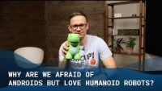
Do you like Robots?
Notes:
https://youtu.be/sbTl_9dTo7Q

Slide 31
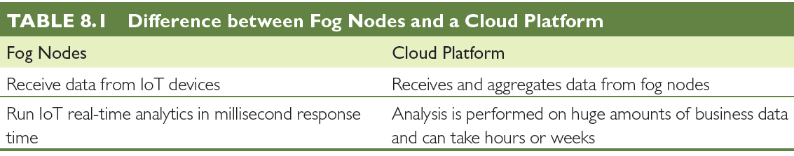
Fog Computing (Edge Computing)
Data produced by IoT is huge in size (problem)
Fog computing is to address the issue by
Proposing fog nodes to process the data close to IoT
Fog nodes – any device including routers or switches
Data Center/Cloud - Fog Device - Physical Device (i.e., sensors that generate the data)

Slide 32
Cloud Computing and Business Analytics
A style of computing in which dynamically scalable and often virtualized resources are provided over the Internet.
Users need not have knowledge of, experience in, or control over the technology infrastructures in the cloud that supports them.
Cloud computing = utility computing, application service provider grid computing, on-demand computing, software-as-a-service (SaaS), …
Cloud = Internet
Related “-as-a-services”: infrastructure-as-a-service (IaaS), platforms-as-a-service (PaaS)

Slide 33
Cloud Computing Example
Web-based email - cloud computing application
Stores the data (e-mail messages)
Stores the software (email programs)
Centralized hardware/software/infrastructure
Centralized updates/upgrades
Access from anywhere via a Web browser
e.g., Gmail
Web-based general application = cloud application
Google Docs, Google Spreadsheets, Google Drive,…
Amazon.com’s Web Services

Slide 34
Cloud Computing Example
Cloud computing is used in
e-commerce, BI, CRM, SCM, ERP, EDW, …
Business model
Pay-per-use
Subscribe/pay-as-you-go
Companies that offer cloud-computing services
Google, Yahoo!, Salesforce.com
Amazon, IBM, Microsoft (Azure)
Sun Microsystems/Oracle

Slide 35
Flavors of Service Oriented Architecture
Data as a Service (DaaS)
Software as a Service (SaaS)
Platform as a Service (PaaS)
Infrastructure as a Service (IaaS)
…
Why so many .aaS is emerging?

Slide 36
Cloud Deployment Models
Private cloud
Public Cloud
Hybrid cloud

Slide 37
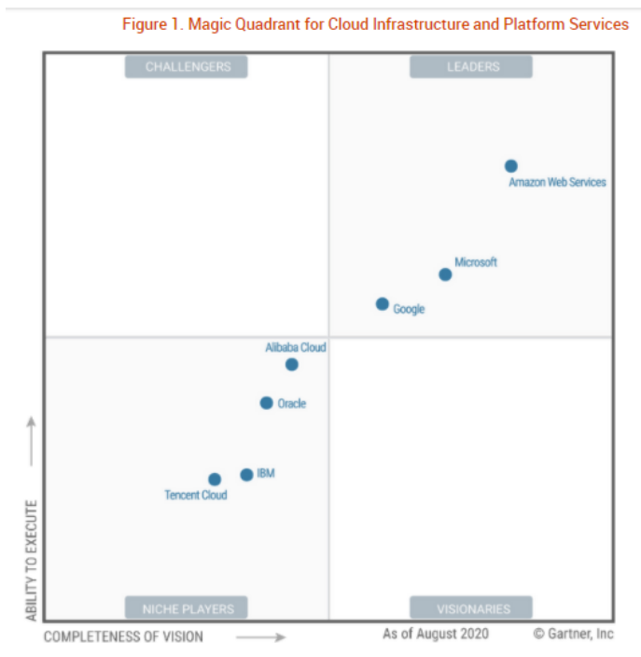
Cloud Service Providers

Slide 38
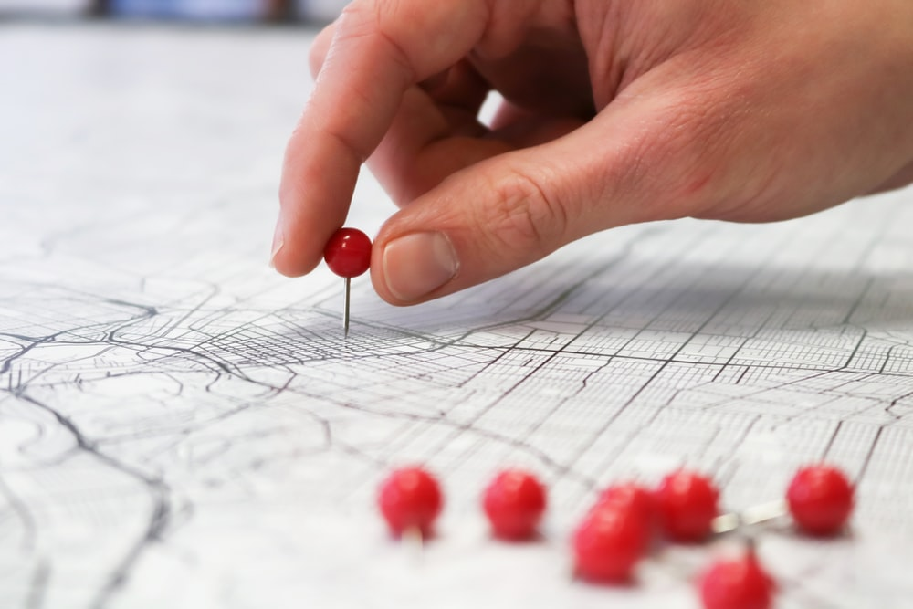
Location-Based Analytics
Everything happens “Some where”
Geospatial Analytics
Geocoding
Visual maps
Postal codes
Latitude & Longitude
Integrate “where” into customer view

Slide 39
Applications of Location-Based Analytics
Insurance
Retail / Logistics
Banking
Restaurants and Cloud kitchens
Healthcare / Education
Hospitality
Public sector and government services

Slide 40
Use of Location-Based Analytics
Retail + Location + Demographic data => 360 view of your customer
Sales vary by population level
Locational proximity to other competitors
Demand variations
Target by customer segments
…
Efficiency of supply chain
Analyze customer/complaints

Slide 41
GIS and Location Intelligence (LI) Applications
In addition to business/retail applications, GIS based analytics are being used in
Agricultural applications
Crime analysis
Disease spread prediction
LI can be combined with weather and environmental data to create a richer data/information infrastructure

Slide 42
Real-Time Location Intelligence
Many devices are constantly sending out their location information
Cars, airplanes, ships, mobile phones, cameras, navigation systems, …
GPS, Wi-Fi, RFID, cell tower triangulation
Reality mining?
Real-time location information = real-time insight
Path Intelligence (pathintelligence.com)
Footpath – movement patterns within a city or store
How to use such movement information

Slide 43
Analytics Applications for Consumers
Explosive growth of the apps industry
iOS, Android, Windows, Blackberry, Amazon, …
Directly used by consumers (not businesses)
Enabling consumers to become more efficient
Interesting Examples
CabSense – finding a taxi in New York City
Rating of street corners; interactive maps, …
ParkPGH – finding a parking spot
Downtown Pittsburgh, Pennsylvania

Slide 44
Impacts of Analytics on Organizations
New Organizational Units
BI department
Data science department
BI Center of Excellence (COE)
Chief Data Officer (CDO)
Increased use of Analytics
People/HR analytics
Impact on Managers
Data/fact/analytics driven decision
Managers’ Activities, Performance, and Job Satisfaction

Slide 45
Potential Impacts of Data Science and Analytics on Managers
Less expertise/experience is requirement
Faster decision making (augmented with analytics)
Less reliance on experts and analysts (data rules!)
Information needed for high-level decision making is expedited or even self-generated (self service analytics)
Automation of routine decisions or phases in the decision-making process may eliminate some managers.

Slide 46
Impacts of Analytics in Organizations
Industrial Restructuring
AI, IOT, analytics, and cognitive computing can change the industry in a fundamental way
Automation’s Impact on Jobs
Data science and AI will change the nature of human jobs (another wave of automation is in the horizon)
Unintended Effects of Analytics
Social and long-term effects of the models: “Weapons of Math Destruction: How Big Data Increases Inequality and Threatens Democracy”

Slide 47
Data Science Benefits
Data Science benefits individuals and organizations
Personalized service
Detection of fraud and abuse
Efficient use of resources
Prevention of failure or accident
Crime prevention

Slide 48
Issues of Legality, Privacy, and Ethics
Legal issues to consider
What is the value of an expert opinion in court when the expertise is encoded in a computer?
Who is liable for wrong advice (or information) provided by an intelligent application?
What happens if a manager enters an incorrect judgment value into an analytic application?

Slide 49
Issues of Legality, Privacy, and Ethics
Privacy - The right to be left alone and the right to be free from unreasonable personal intrusions
Collecting information about individuals
How much is too much?
Mobile User Privacy
Location-based analysis/profiling
Homeland Security and Individual Privacy
Recent Issues in Privacy and Analytics
“What They Know” about you (wsj.com/wtk)
Rapleaf (rapleaf.com), X + 1 (xplusone.com), Bluecava (bluecava.com), reputation.com, sociometric.com...
Who owns our private data?

Slide 50
Issues of Legality, Privacy, and Ethics
Ethics in Decision Making and Support
Electronic surveillance
Software piracy
Invasion of individuals’ privacy
Use of proprietary databases
Use of knowledge and expertise
Accessibility for workers with disabilities
Accuracy of data, information, and knowledge
Protection of the rights of users
Accessibility to information
Personal use of corporate computing resources
… more in the book

Slide 51
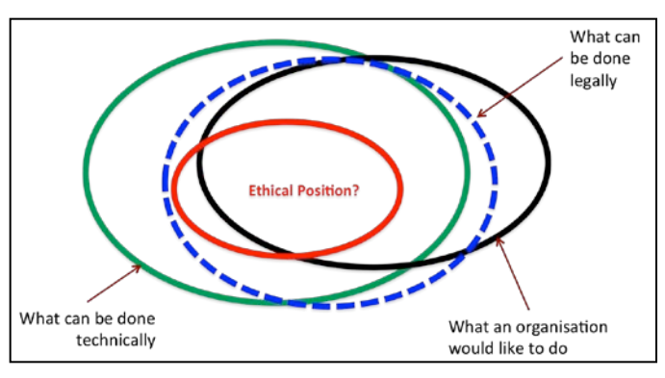
Data Science Ethics

Slide 52
Golden Rule of Ethics
Golden Rule
Just because you can do something, doesn’t mean you should

Slide 53

Crime Prediction
Notes:
https://www.youtube.com/watch?v=jdl6eAIx2K4
https://www.youtube.com/watch?v=7Dlo-VB0-HI

Slide 54
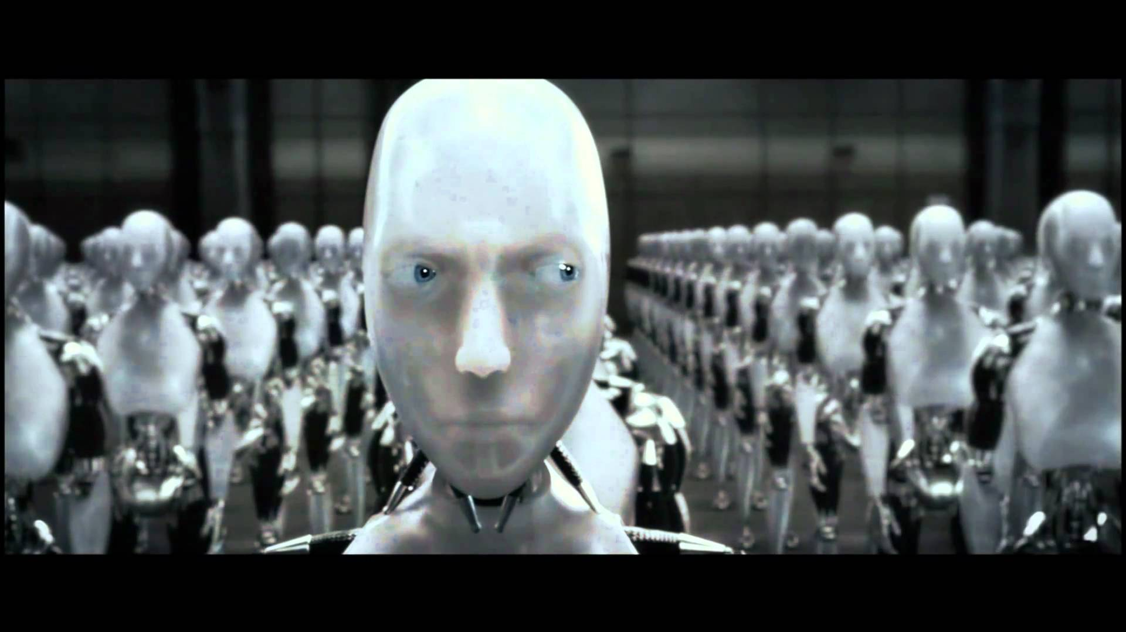
Conclusion
Human agency is needed
We cannot turn into a society run by algorithms (movie: iRobot)
Final decision must involve a human being

Slide 55

Q&A
What questions and comments do you have?

